Slide 1


IoT BASED AUTOMATED STREET LIGHTING SYSTEM
Experiment 1
Raphael S. Nano
CPE162P / C1
Computer Engineering Department
School of Electrical, Electronics, and Computer Engineering

Slide 2
Introduction: IoT Based Automated Street Lighting System
In the modern generation of continuously developing technology, urban cities around the world are responding to innovative solutions in order to further the efficiency in the city structures and roads.
Example: IoT-based automatic street lighting systems

Slide 3
Objectives
To demonstrate how an IoT based Automated Street Lighting System works.
To be able apply what you have learned in logic circuits and switching theory, microprocessors, CPE160P, and CPE161P.
To be able to apply embedded system with IoT using Arduino kit
To be able to use ThingSpeak for the data collection and analysis.

Slide 4
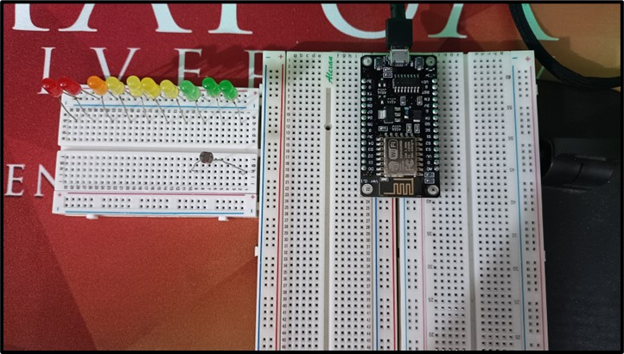
Materials
Hardware
ESP8266 WiFi Module
LEDs
Photoresistor
Notes:
The materials utilized to construct the real-time basketball scoreboard are the Arduino UNO, the 4-digit seven segment display, and 5 switch buttons.

Slide 5
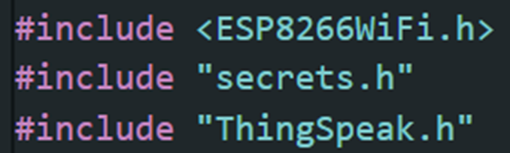
Materials
Software Libraries
ESP8266WiFi.h
ThingSpeak.h

Slide 6
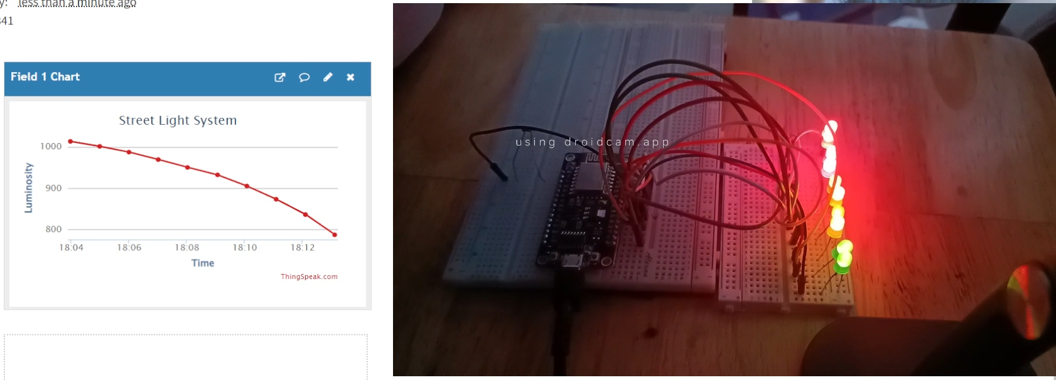
Discussion: IoT Based Automated Street Lighting System
Goal is to create a system, wherein it automatically switches the street light ON and OFF based on the amount of sunlight present
Thingspeak will be used for the collection of the data and analysis

Slide 7
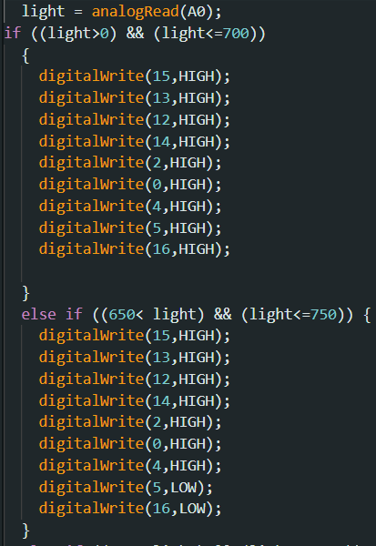

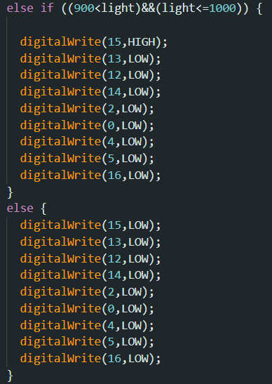
Discussion: IoT Based Automated Street Lighting System
By simply using analogRead and digitalWrite, the LEDs are turned ON
1st Level: 0-700
2nd Level: 650-750
3rd Level: 750-850
4th Level: 850-900
5th Level: 900-1000

Slide 8
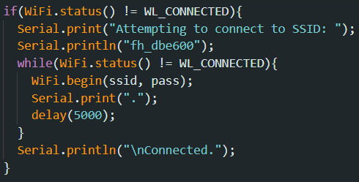
Discussion: IoT Based Automated Street Lighting System
To connect the ESP8266 to Thingspeak, a WiFi connection should first be established.
The code tries to get connected to a particular network using Wi-Fi (fh_dbe600) and repeatedly attempts until an adequate connection is made.
It delivers information to the person using it via the Serial Monitor, indicating the status of the connection attempt.

Slide 9
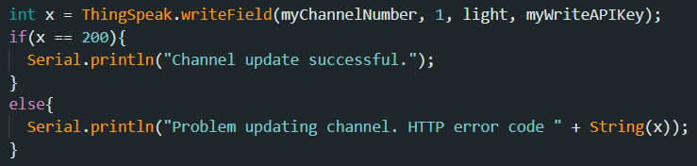
Discussion: IoT Based Automated Street Lighting System
The luminosity value will be passed to the Thingspeak using the writeField function
A value was checked to see if the channel update is successful or not

Slide 10
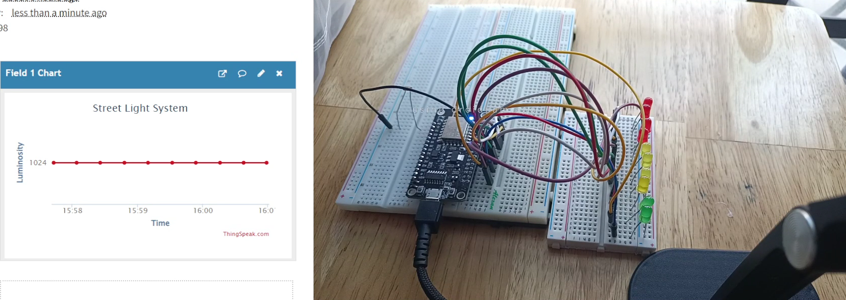
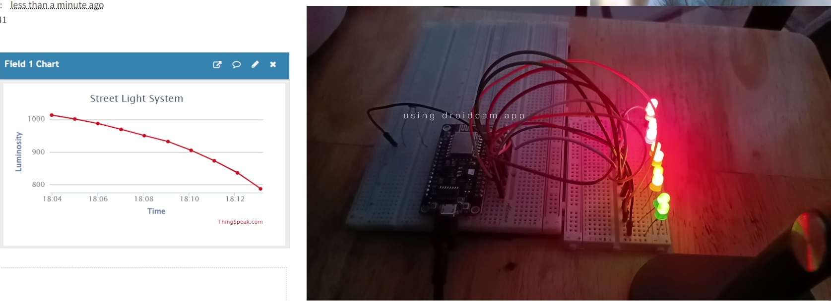
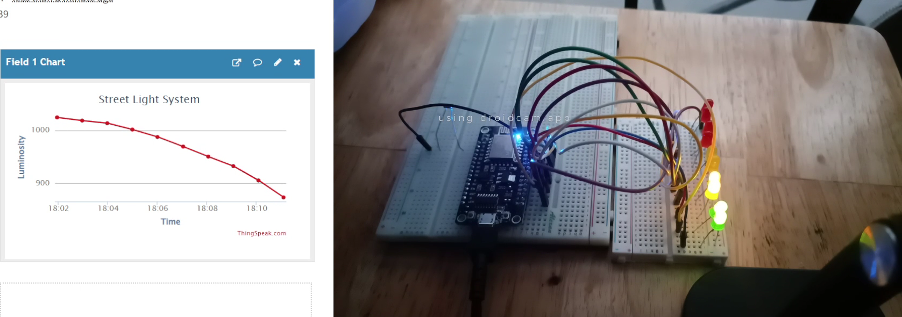
Results: IoT Based Automated Street Lighting System

Slide 11
Conclusion
The IoT-based Automated Street Lighting System works by:
  using a conditional statement
  the outputs of the LEDs depend on the intensity of light being received by the photoresistor
  More sunlight would mean less LEDs turned ON, and vice versa

Slide 12
Conclusion
The second objective was achieved by:
  synchronizing the lighting up of LEDs depending on the light received by the photoresistor
  synchronizing the luminosity value in Thingspeak
The IoT portion was successfully integrated with the use of the communication and data writing between ESP8266 and Thingspeak
The IoT-based Automated Street Lighting System was successfully developed with its WiFi connection and the synchronization of outputs of the photoresistor and LEDs in Thingspeak.

